Slide 1
Runtime Evolution: Chaos Engineering & Defect Prediction for Explainable Orchestration
Damian A. Tamburri, Ph.D.

Slide 2


First… Quick Story of DevOps so far!

Slide 3



Slide 4
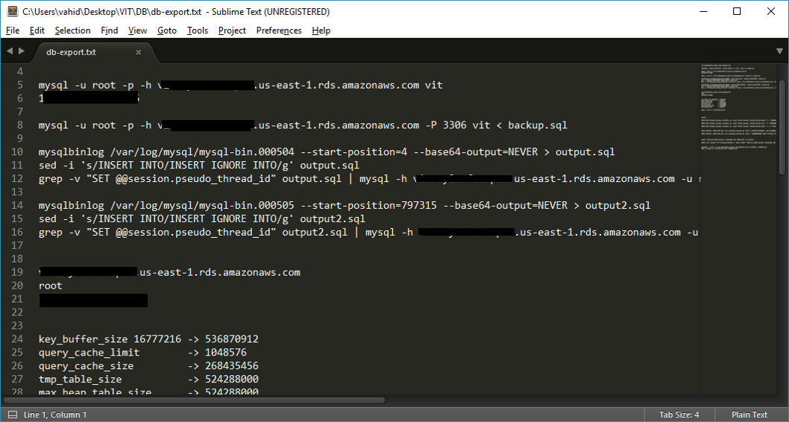
Manuals

Slide 5
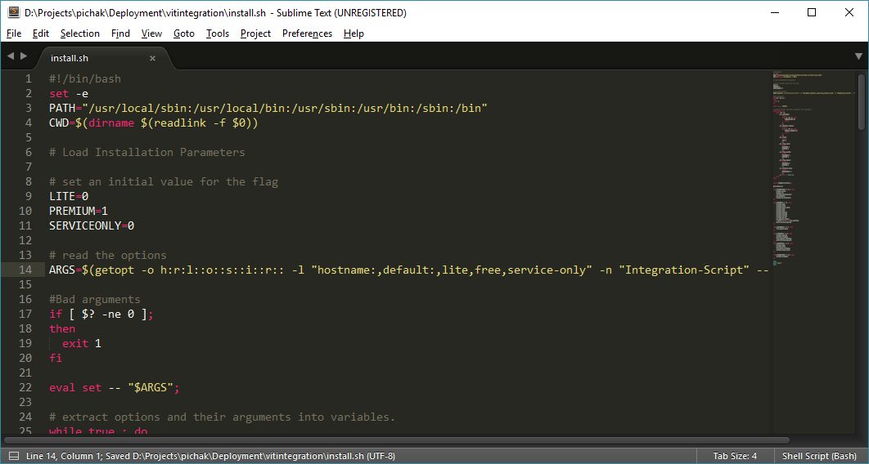
Bash Scripts

Slide 6
Bash Scripts (Pro’s)
Easy to use
Easy to learn
Easy to change
We can use source control (Git)

Slide 7
Bash Scripts (Con’s)
Low Speed
Unorganized

Slide 8

Juju?

Slide 9

Provides a modeling language for users that abstracts the specifics of operating complex big software topologies

Slide 10
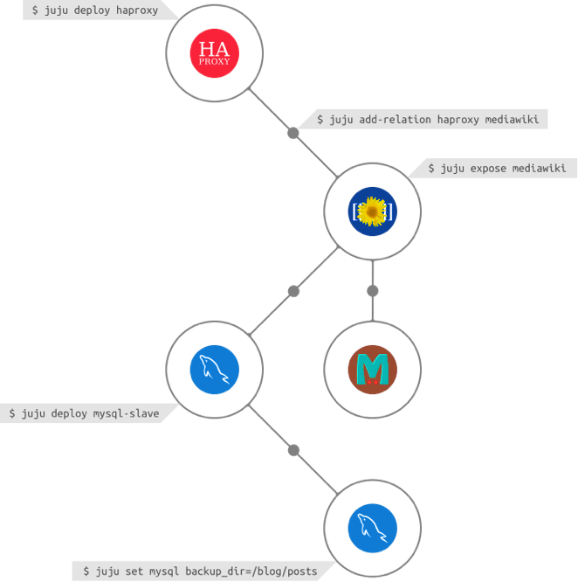


Slide 11
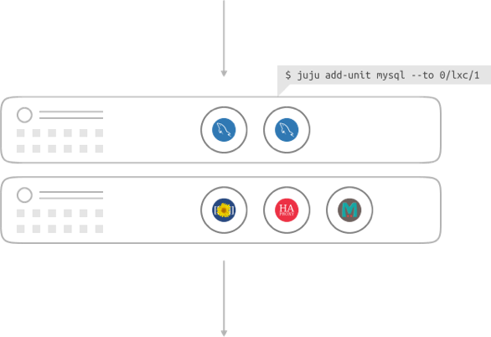

Slide 12

Containers

Slide 14
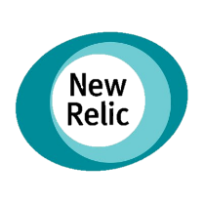









Monitoring
Purchase
Analytics
BL
Alert

Slide 15
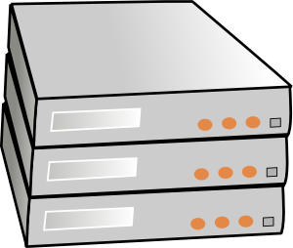





Continues Delivery & Deployment
Notes:
What’s left? Workflow management

Slide 16
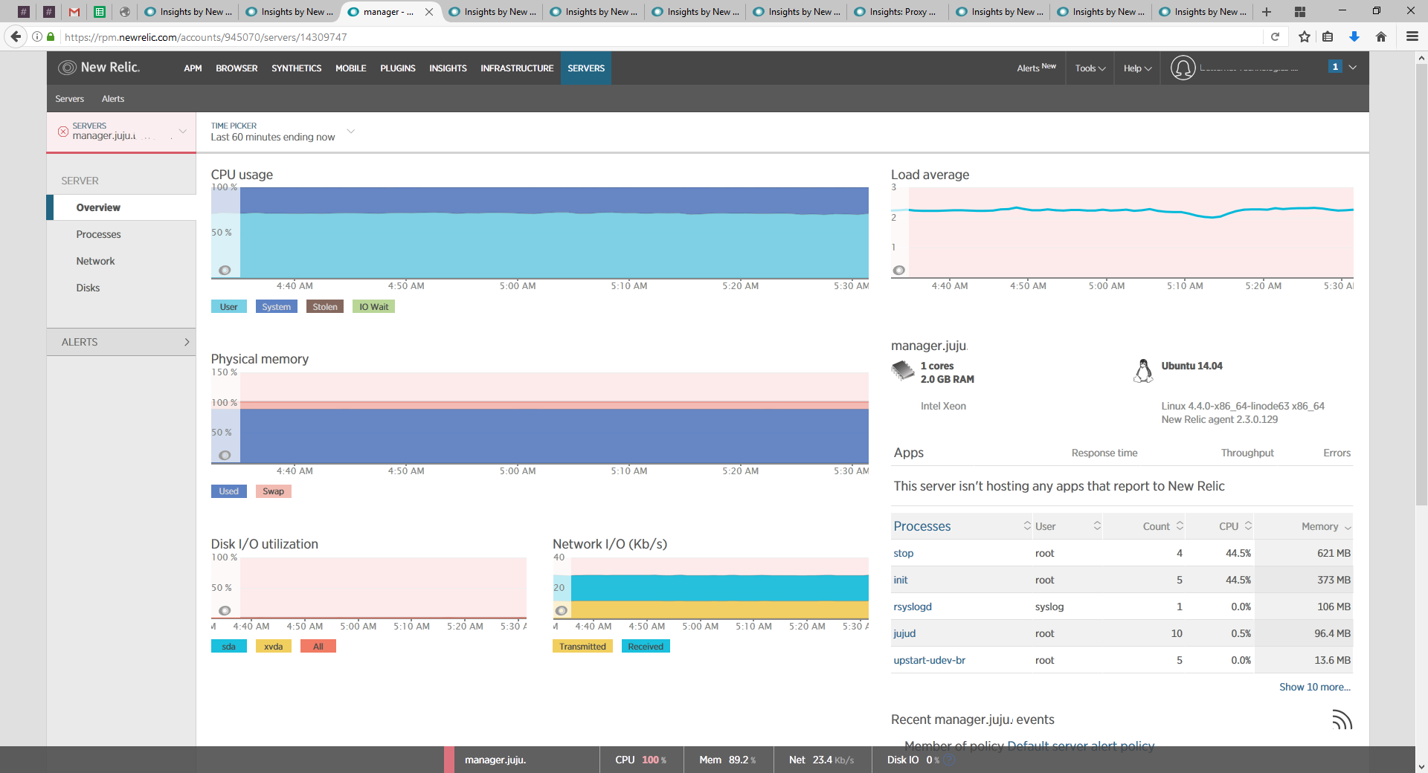
New Relic Servers

Slide 17

Griffin
Gatherer
Runner
Reporter
Cleaner
Checker
Notes:
Pluggable gatherer

Slide 18
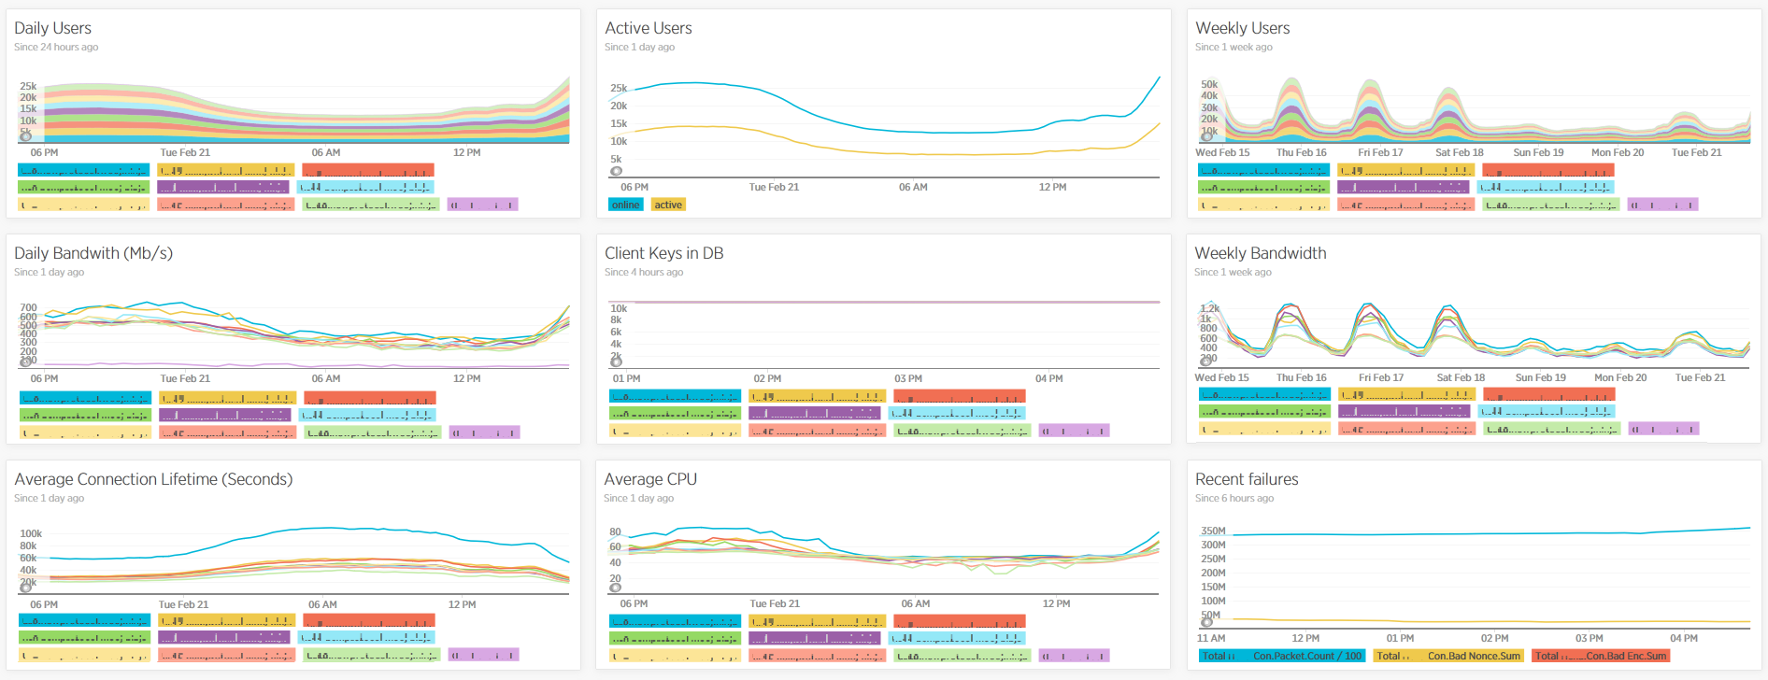
New Relic Insights

Slide 19

DevOps!

Slide 20
Not really…

Slide 21


Slide 22


Slide 23
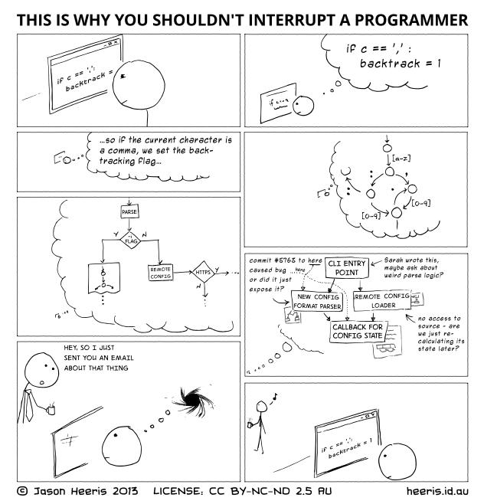
Interrupts!

Slide 24
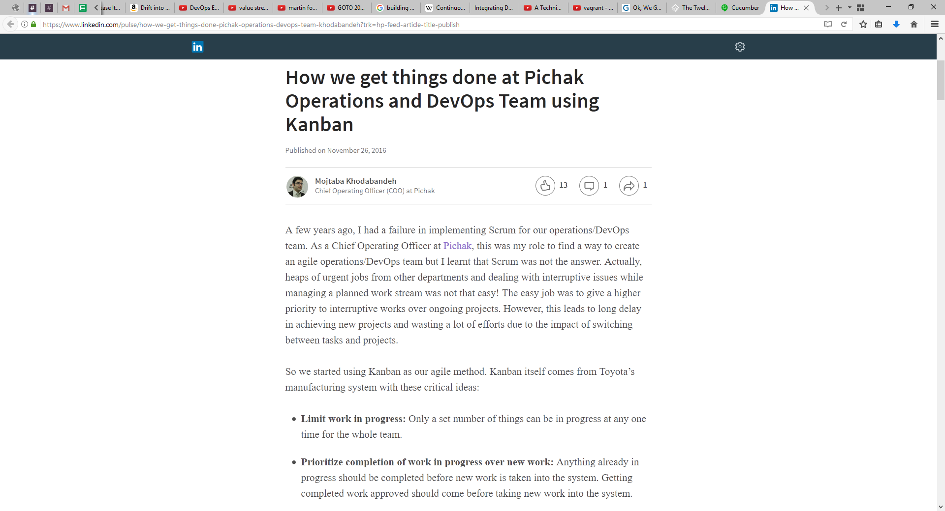
We Need to Change

Slide 25
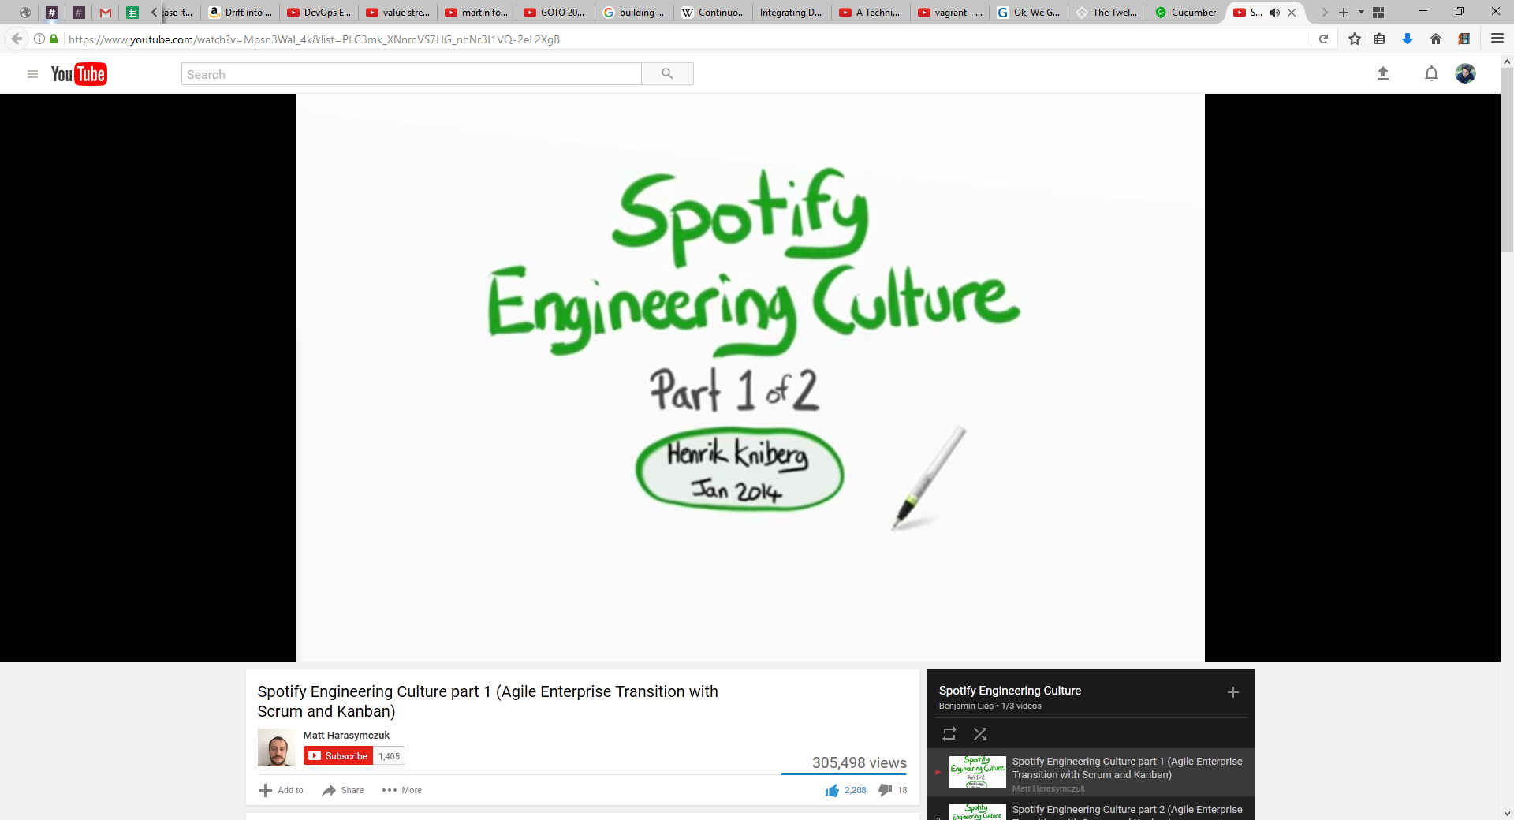
Spotify Culture

Slide 26
How they get things done at Pichak DevOps Team
Basic Ideas of Kanban
Limit work in progress
Prioritize completion of work in progress over new work
Manage the flow of work through the system
Visualize the workflow

Slide 27
Request Channels
Internal
External

Slide 28
Request Channels
Incidents
Tasks
Stories

Slide 29
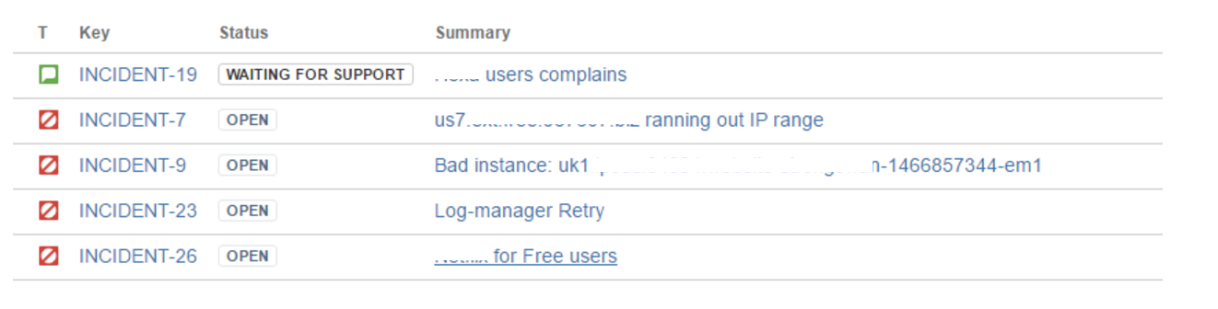
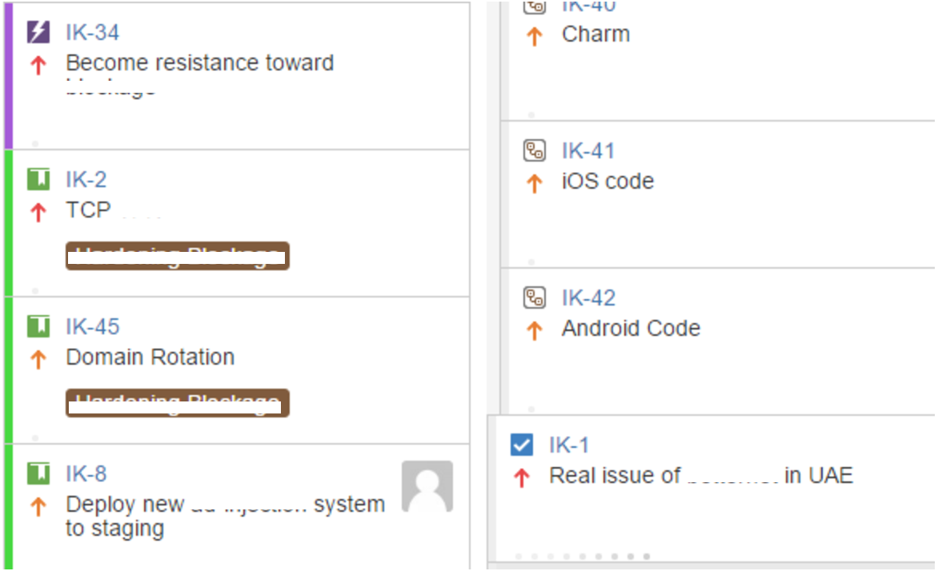
Request Channels
Incidents
Tasks
Stories
Notes:
Time for incidents

Slide 30
Maybe?

Slide 31

So I wrote the code, now what?
Notes:
Just writing the code From Development to Release
From RUP to Agile
Change management

Slide 32

DevOps
Notes:
Start from development to release and operation (maintenance) and also culture
Lower the cost of change

Slide 33







DevOps

Slide 34
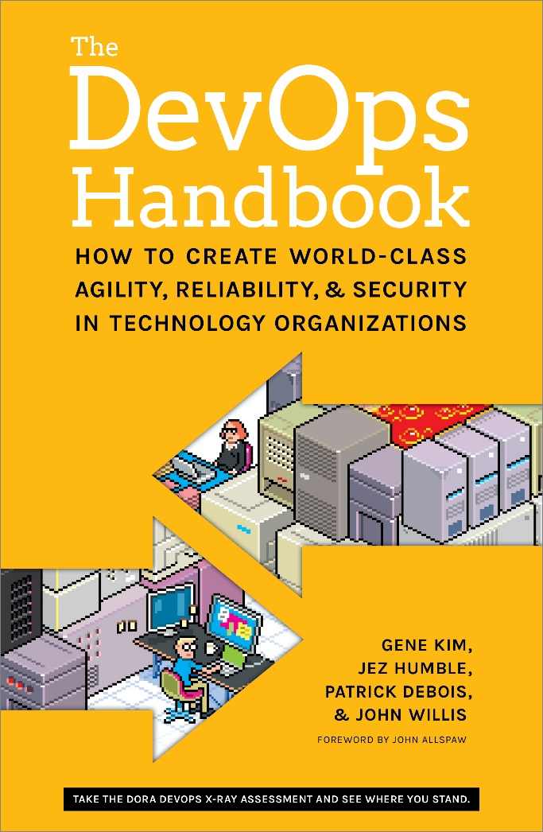
Three Ways of DevOps
The First Way: Accelerate Flow
The Second Way: Amplify Feedback Loops
The Third Way: Accelerate Learning
Notes:
Lets start from scratch All steps from starting point

Slide 35
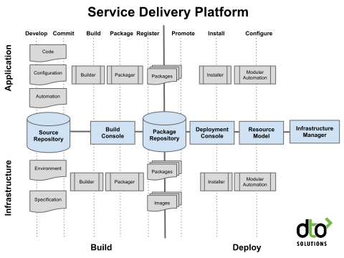
The First Way: Accelerate Flow
Continues Delivery & Deployment
Small and Frequent Changes
Fast and Frequent Deployment
Notes:
Lets start from scratch One step Build and Deployment Automation

Slide 36
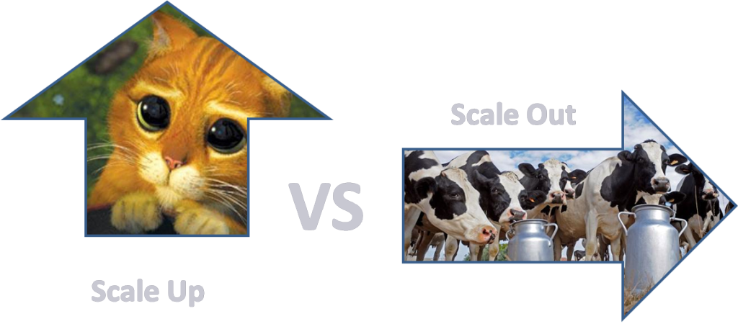
The First Way: Accelerate Flow
Pets vs Cattle

Slide 37
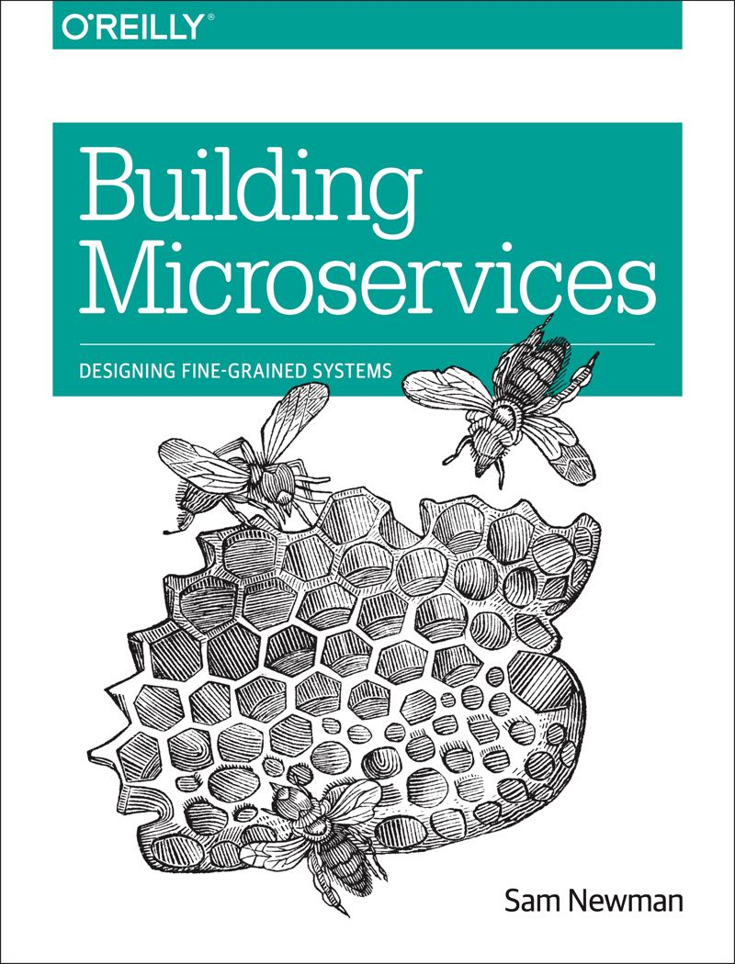
Microservices

Slide 38

The First Way: Accelerate Flow
Two-Pizza Team
From Idea to Release

Slide 39
The Second Way: Amplify Feedback Loops
Goals:
Right to Left
Find and Fix Fast
Shorten and Amplify Feedback

Slide 40
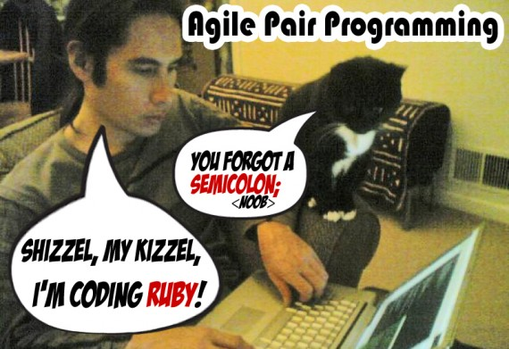
The Second Way: Amplify Feedback Loops
Fast Feedback
Peer review and pairing
Contingency
Design for failure
Feedback loops
Developer managed service

Slide 41
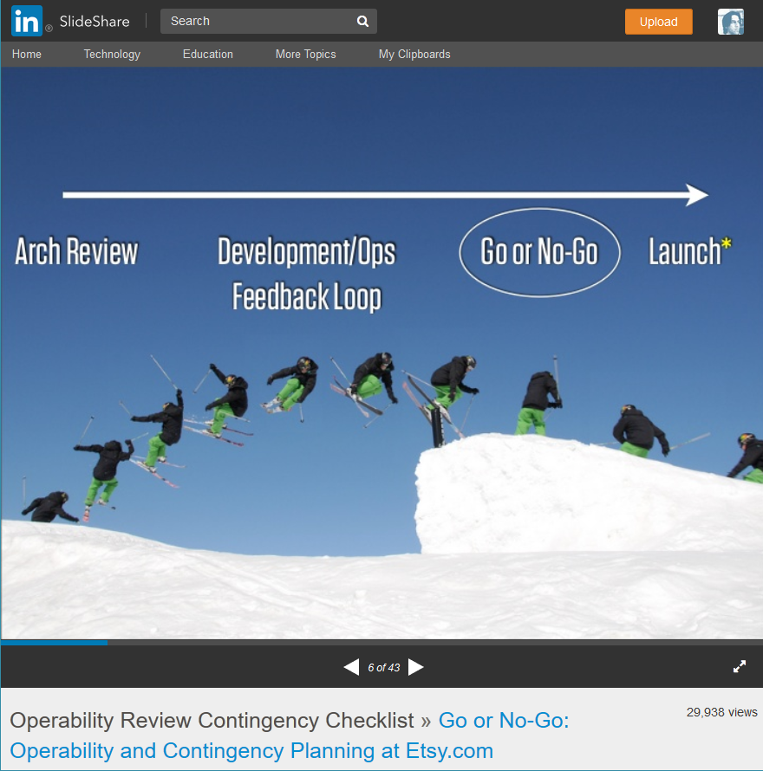
The Second Way: Amplify Feedback Loops
Etsy Operability Review Contingency Checklist:
When will it be launched
Who is launching it
Has it been in production yet
Can it be dark, feature or percentage launched
Is it new infrastructure
Has an on off switch
All parties available at launch time

Slide 42

The Second Way: Amplify Feedback Loops
Deploys – Upgrading Live Services
Canary
Rolling upgrades
Blue green deploy
Dark deploys
Toggling feature
A/B testing

Slide 43
The Second Way: Amplify Feedback Loops
Monitoring : Looking at Service Stack
Business indicators
Application indicators
Infrastructure indicators
User based indicators
Deployment indicators

Slide 44
The Second Way: Amplify Feedback Loops
Monitoring : Google’s Four Golden Signals
Latency
Traffic
Errors
Saturation
Notes:
Do we need to monitor everything?

Slide 45
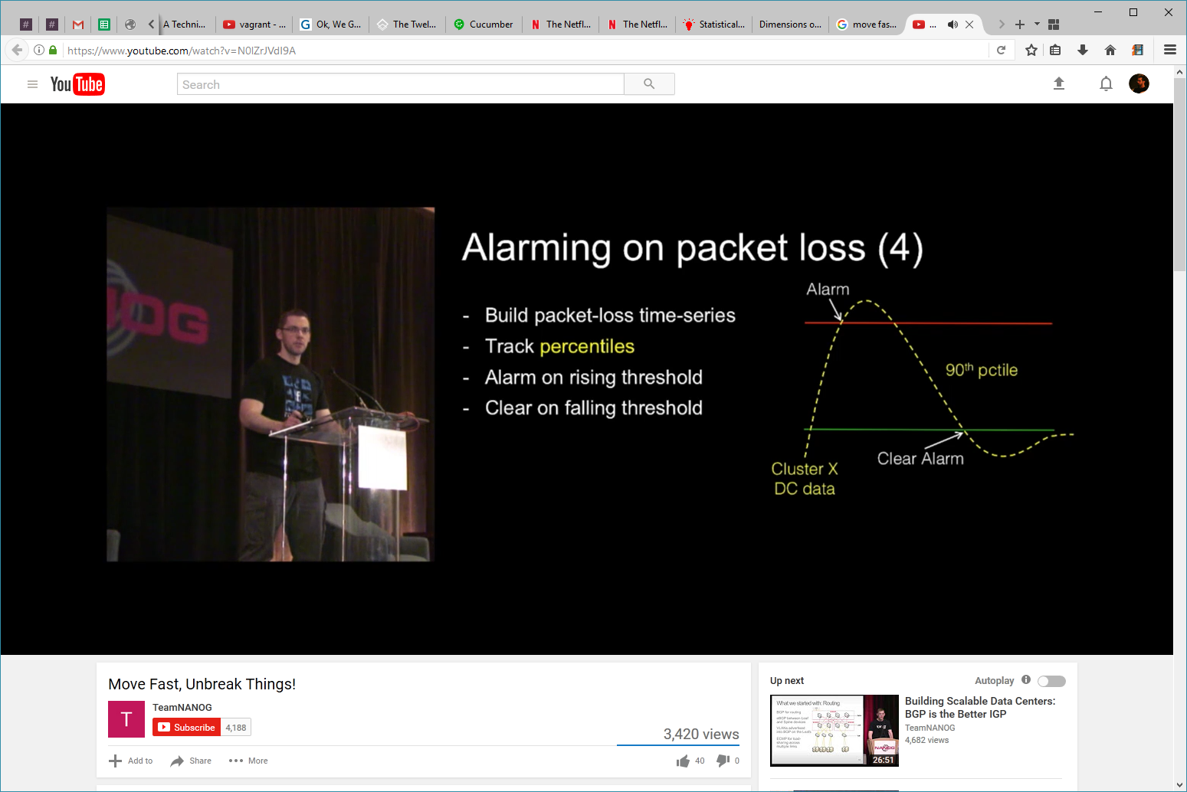
The Second Way: Amplify Feedback Loops

Slide 46
The Second Way: Amplify Feedback Loops
Design for failure
Notes:
100% reliability myth

Slide 47


The Second Way: Amplify Feedback Loops
Design for failure
The Netflix Simian Army
Chaos Monkey
Latency Monkey
Conformity Monkey
Doctor Monkey
Janitor Monkey
Security Monkey
10-18 Monkey
Chaos Gorilla
Notes:
100% reliability myth

Slide 48
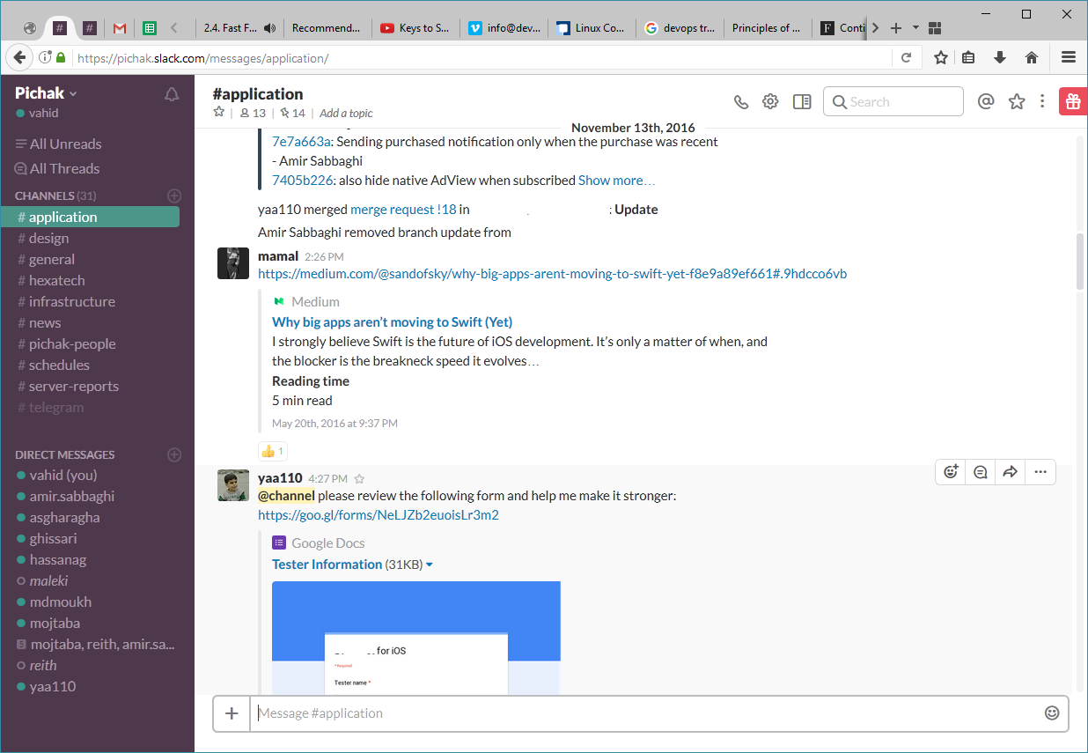
The Second Way: Amplify Feedback Loops
ChatOps

Slide 49
The Third Way: Accelerate Learning
Learning Organizations
Communication
Blameless Culture

Slide 50
The Third Way: Accelerate Learning
Learning Organizations
Psychological safety
Appreciation of difference
Openness to new ideas
Time for reflection
Systematic knowledge sharing
Education and experiment
Reinforced learning

Slide 51
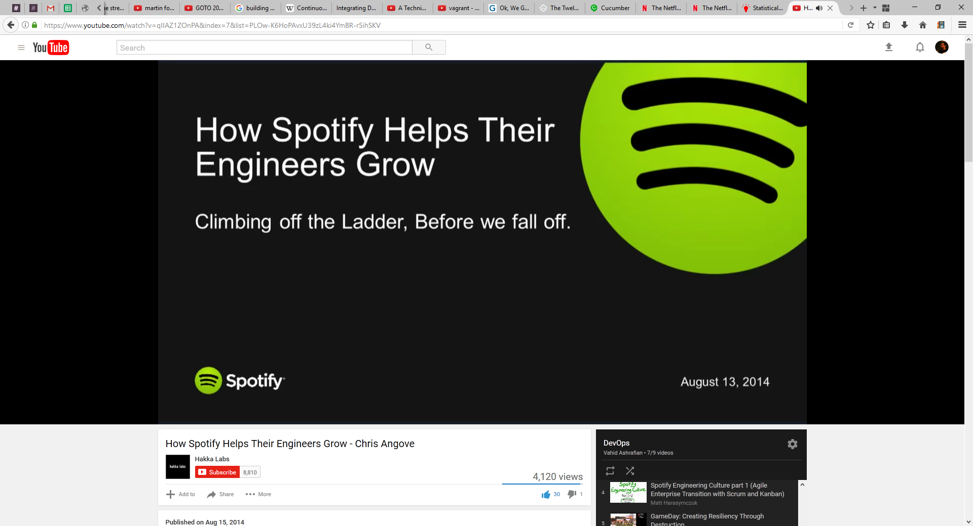
The Third Way: Accelerate Learning
Learning Organizations
Communication

Slide 52
The Third Way: Accelerate Learning
Blameless Culture
A blameless culture believes that systems are NOT inherently safe and humans do the best they can to keep them running.
Notes:
Blameless Postmortem

Slide 53
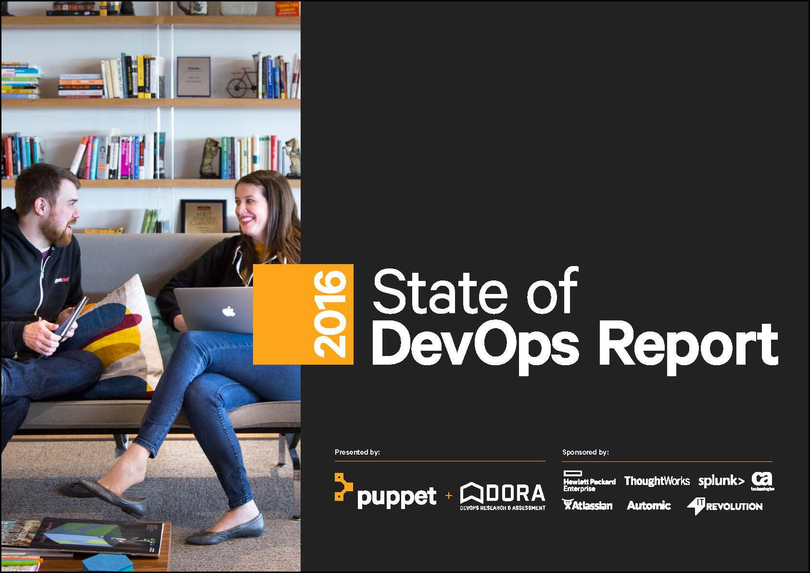
High-performing organizations

Slide 54
High-performing organizations
Deploy 200 times
2,555 times faster lead times
recover 24 times faster
three times lower change failure rates

Slide 55

Your Story

Slide 56
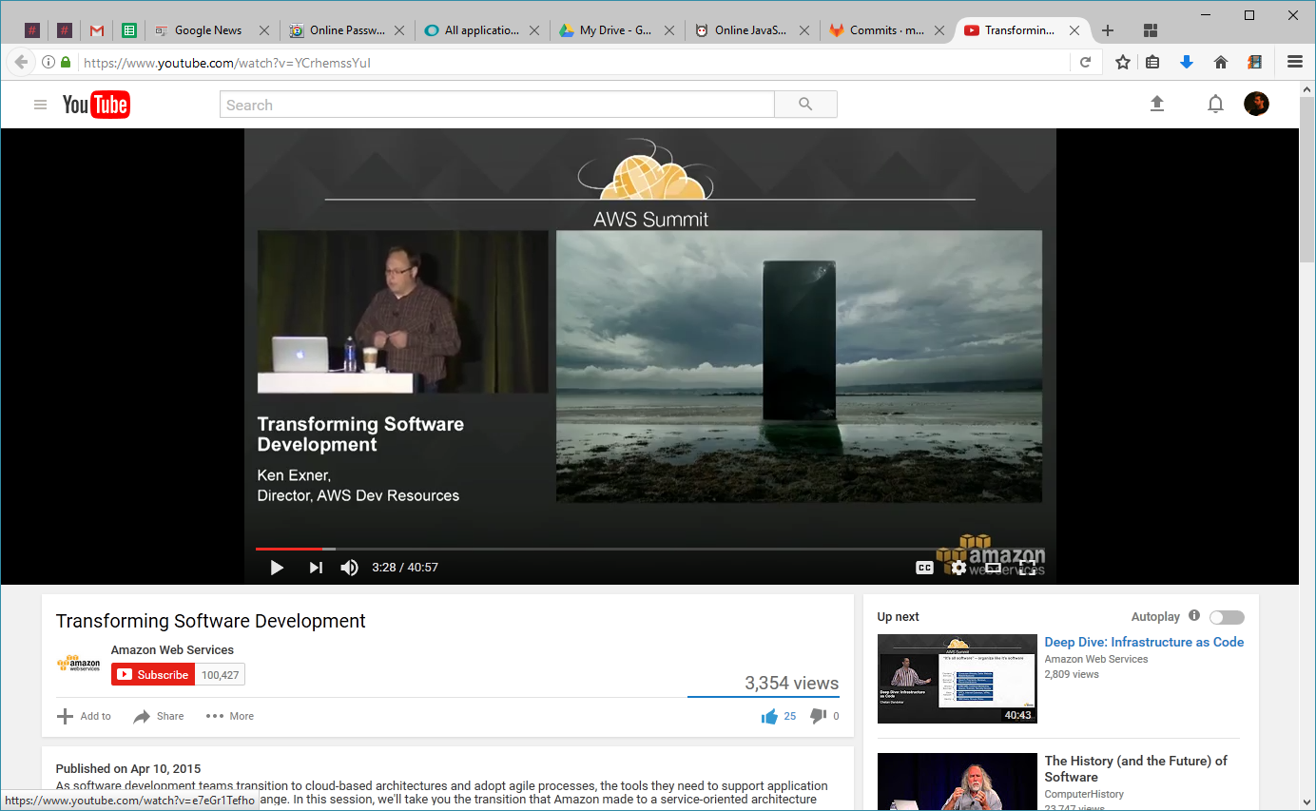
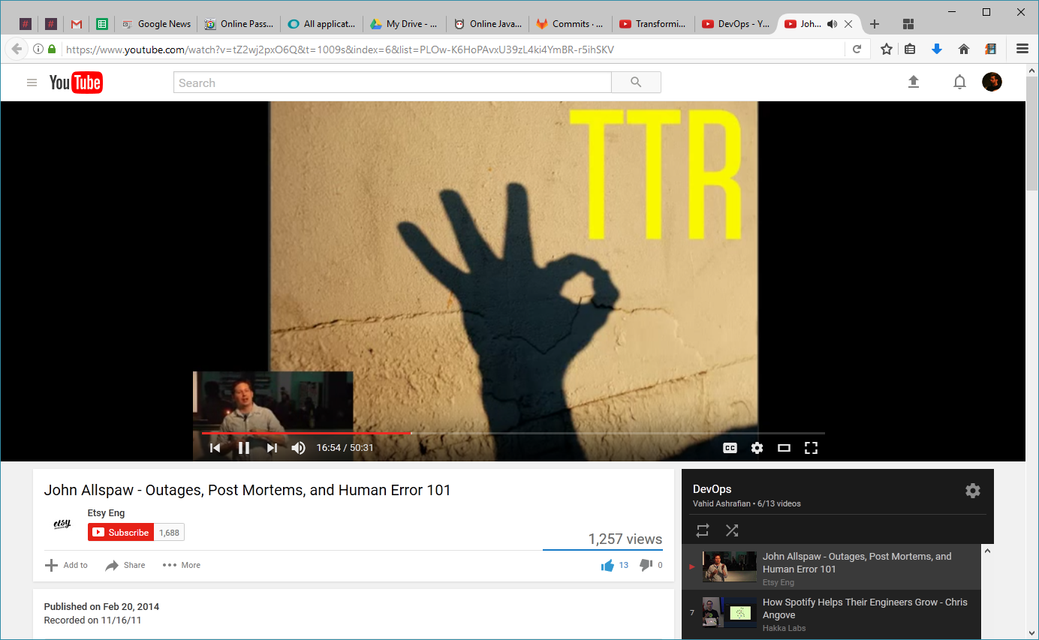
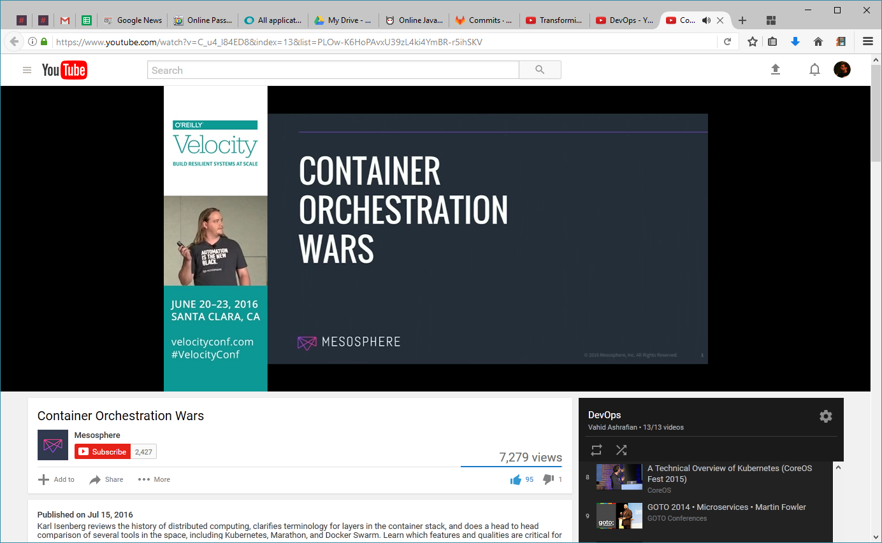
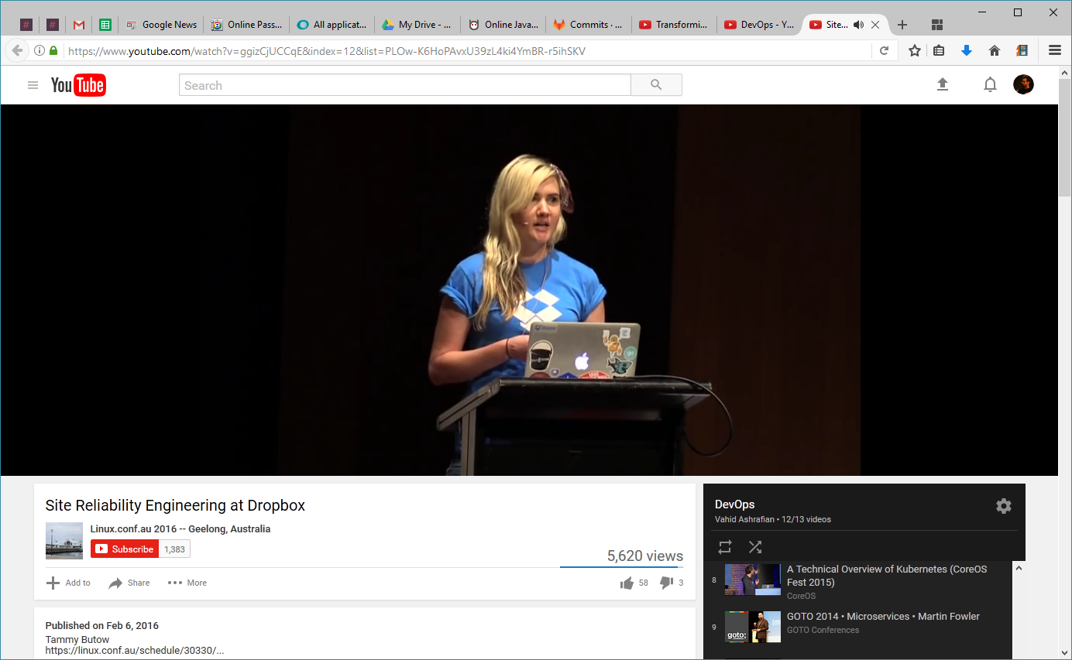
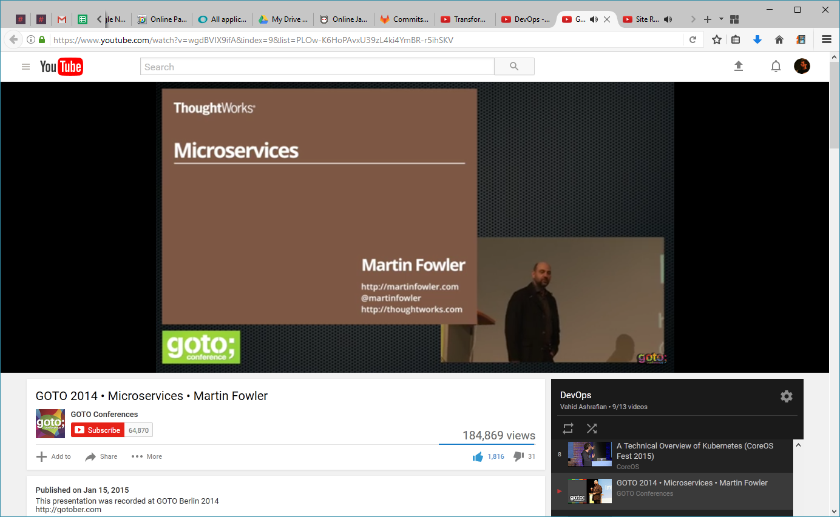
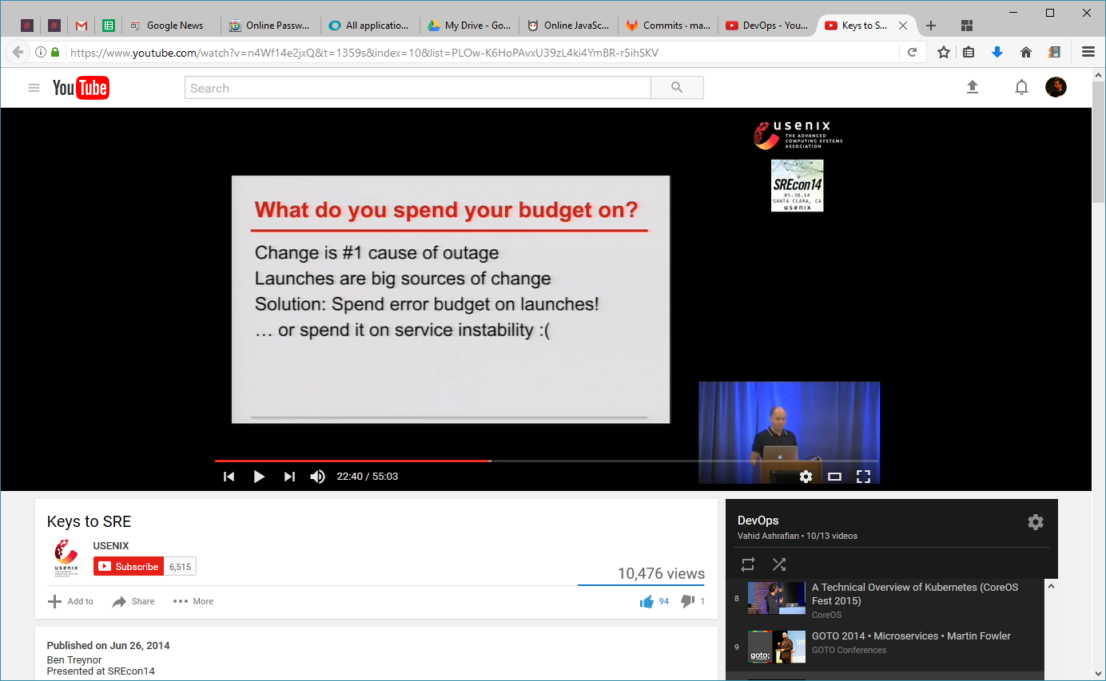

Slide 57
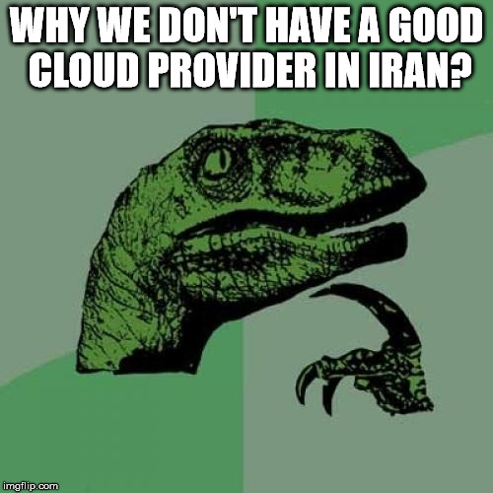
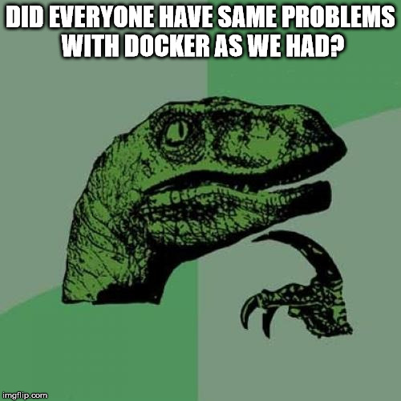



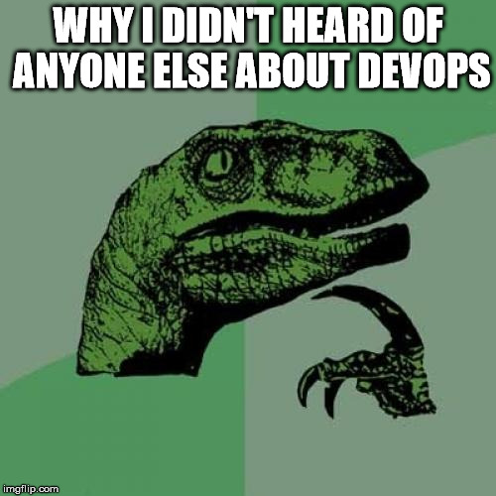

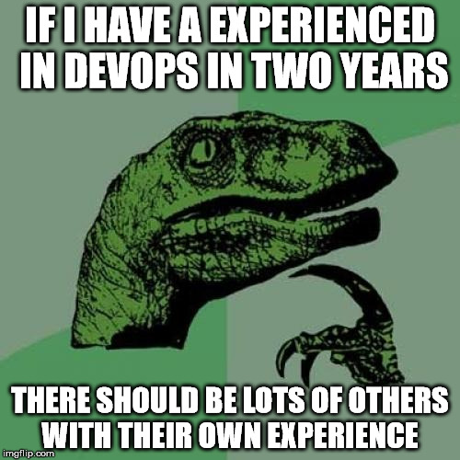

Slide 58

We Need More Stories!

Slide 59
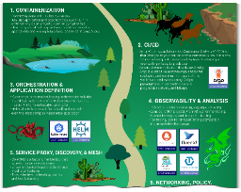
What is Cloud Native Computing
Context
The CNCF published the following definition of cloud native:
“Cloud native technologies empower organizations to build and run scalable applications in modern, dynamic environments such as public, private, and hybrid clouds.
Containers, service meshes, microservices, immutable infrastructure, and declarative APIs exemplify this approach.
These techniques enable loosely coupled systems that are resilient, manageable, and observable.
Combined with robust automation, they allow engineers to make high-impact changes frequently and predictably with minimal toil.”
CNCF Trail Map
Recommended process for leveraging open source, cloud native technologies.
Containerization
CI/CD
Orchestration & Application Definition
Observability & Analysis
Service proxy, discovery & mesh
Networking, policy & security
Distributed database & storage
Streaming & messaging
Container registry & runtime
Software distribution
Cloud Native applications by IBM (link)
Cloud native refers less to where an application resides and more to how it is built and deployed. Microservices are…
Building blocks working together, often packaged in containers
Scaled independently
Continuously improved, quickly iterated via automation / orchestration
Cloud native. Built to operate only in the cloud environment.
Cloud enabled. Traditional app, later adapted to run in a cloud environment.
Cloud ready. Traditional or Cloud app has been reconfigured for a cloud environment.
Cloud based. Delivered over the Internet.
Cloud first. Business strategy in which an organization commits to a cloud approach.
CNCF considers these to be essential for cloud native
Notes:
https://github.com/cncf/toc/blob/master/DEFINITION.md
https://github.com/cncf/trailmap
https://www.ibm.com/cloud/learn/cloud-native

Slide 60
What is Cloud Native Network Function (CNF)
Context
The CNCF TUG published the following definition of cloud native network function:
“A cloud native network function (CNF) is a cloud native application that implements network functionality.
A CNF consists of one or more microservices and has been developed using Cloud Native Principles including immutable infrastructure, declarative APIs, and a “repeatable deployment process”.
Containers in Telcos – Are We There Yet? (SDX Central, Feb 2019)
“Now, as we move into the world of containers, we’re moving forward with much less structure on how to achieve this new concept labelled cloud-native network functions (CNF) – again, a fancy term for, primarily, container technology coupled with microservices architecture.
Squeezing a big fat VM into a container isn’t CNF. To get to cloud-native network functions we need to take a VNF and break it into component microservices. And then we need to figure out how to orchestrate those pieces and turn over control to Kubernetes.”
CNF and VNF verification with Red Hat and Intel (Red Hat, Mar 2020)
“CNFs are more than just the containerization of network functions. To get the full benefit of Cloud Native principles beyond container packaging requires further rearchitecting of CNFs, like decomposition, allowing multiple versions during updates, and supporting provided platform services like generic load-balancers or datastores.”
Notes:
https://github.com/cncf/telecom-user-group/blob/master/whitepaper/cloud_native_thinking_for_telecommunications.md#1.4
https://www.sdxcentral.com/articles/analysis/containers-in-telcos-are-we-there-yet/2019/02/
https://www.redhat.com/en/blog/cnf-and-vnf-certification-red-hat-and-intel

Slide 61
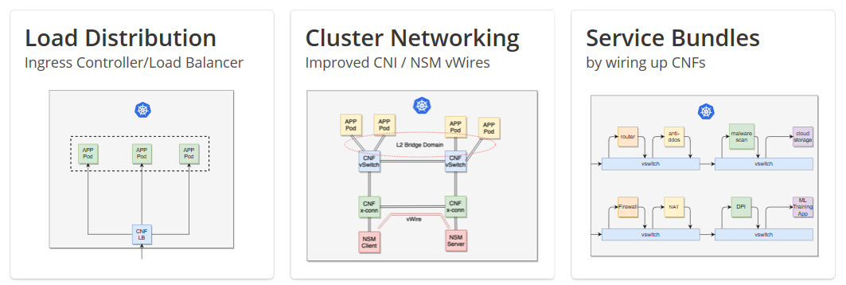
Context
CNF Solution Scenarios

Slide 62
Background
While Network Functions move toward modern cloud platforms, we see two slightly different approaches.
The ‘containerized’ approach is following the first step of the CNCF Trail map .
The ‘Cloud Native’ approach is usually a deeper re-architecture of the Network Function.
ONAP should be able to support both approaches

Slide 63
Background
‘Containerized’ network functions are basically a port of a virtualized or even physical network function
Typically uses Docker containers.
Size of containers may vary, but it is not uncommon to see very large containers that are the result of converting a VM image to a Docker image.
No strict break down into distinct micro services that perform a very specific task.
May include some components as virtual machines.
Typically makes limited use of services offered by the Container Orchestration Engine (COE)

Slide 64
Cloud Native Network Functions
This approach is designed to make the most out of the transition to the cloud infrastructure
It may come as a later evolutionary phase of a ‘containerized’ application, or be the result of building the network function from the ground up with cloud-native-ness in mind
The following slides will describe this approach in detail so we can come to a common understanding in the ONAP community about the meaning of the term ‘cloud-native’

Slide 65
Cloud Native
Cloud Native is an approach to building and running applications in a cloud computing delivery model.
Cloud Native is about how applications are built, deployed and managed (not where).
An application is considered Cloud Native by following the Cloud Native Principles.
Technologies and tool choices are considered independently from Cloud Native Principles.
Aligned with CNCF definition of Cloud Native.
Cloud Native Infrastructure
Cloud Native Infrastructure is all the software and hardware that support cloud native applications.
Includes the underlying hardware, operating systems and platform software.
Includes deployment pipelines, configuration management.
Enables all the Principles that a Cloud Native application must follow.
Provides abstractions behind APIs for cloud native workloads to interact with.
Infrastructure is managed by software in order to run applications in a scalable way.
Also follows all the Principles that a Cloud Native application must follow.
Cloud Native Network Function
Cloud Native network function (CNF) is a cloud native application that implements network functionality.
CNFs are built, deployed and managed just like any other Cloud Native apps.
CNFs are considered Cloud Native by following the Cloud Native Principles.
CNFs may have high performance and security requirements, but that is considered independently from Cloud Native Principles.
CNFs may need specific resources from the infrastructure, but requested from a pool of resources.
CNFs should generally run in containers and request the minimum set of resources to operate.
Aligned with CNCF / TUG definition of Cloud Native Network Function.

Slide 66
Modern Cloud Native Design Principles
Principle | Description
Platform Capabilities Driven | Workload is portable within a cloud platform – while it may need particular type of device from a resource pool, it doesn't require a specific instance of that device or host. Workload cannot design to a specific hardware or software platform release level, version or patch. The workload is built independent of the infrastructure and orchestration platform. Workload cannot design to a specific kernel (i.e., one kernel for all containers running on a server). Workload uses open interfaces, approaches and ecosystem tools aligned with these Principles. Workload stores its state within the orchestration engine, not an external database.
Immutable | If the workload needs to change, then redeploy a new workload. Workload is designed so that the operators just signal a restart when needed (no login required). Deployed workload (application and configuration) is protected from change. Infrastructure includes software platform and physical hardware. if the infrastructure needs to update for whatever reason, it changes. Workload doesn’t notice.
Declarative | Express intentions for the desired state. Declaration is the source of truth. Designates what to do, not how to do it.
Predictable | Declarative input drives consistent platform behaviors (desired state is expressed up front). Immutable infrastructure drives consistent platform behaviors (redeploy a workload when change is needed). Deployments are planned, repeatable, consistent.
Modular | Functions are broken down into smaller units to enable individual startup, scaling, updates or shutdown. Packaging as one-process containers reinforces right-sized smaller units. Ability to scale dynamically by independently increasing/decreasing resources around a spike. Aligns with loosely coupled microservices based architecture.

Slide 67
Modern Cloud Native Design Principles (cont’d)
Principle | Description
Automation | Ability to idempotently repeat an activity. Ability to be scheduled. Engineered for a CI/CD model: continuous deployment for frequent, faster updates as needed.
Orchestration | Each modular unit can be independently scheduled and managed for resource optimization. Platform manages availability, provisioning, and deployment of containers. Platform manages scaling across infrastructure. Workload is portable within the same cloud platform.
Statelessness | Stores state independent of specific infrastructure, enables highly distributed approach. Workload uses a protocol that allows for a session to continue seamlessly, even when there are drops. HTTP operates this way.
Resiliency | Ability to self-heal, self-scale and operate when the platform has a partial failure. Workload gracefully hands off service request during outage - either planned or unplanned.
Monitoring | Ability to be programmatically monitored via standard approach (health check: liveliness and readiness probes) Aligns to standard ecosystem tooling for metrics / export. Similar to CNCF "Observability & Analysis" - check progress or quality over a period of time, and determine health.
Tenancy | Workload should assume that other workloads are running on the platform. Workload should assume that there is no specific, dedicated hardware. Workload should request the bare minimum level of privileged access (eg, don’t assume admin rights).

Slide 68
What’s the key?
Moment of suspense…

Slide 69


Slide 70
So… what’s the actual problem?

Slide 71
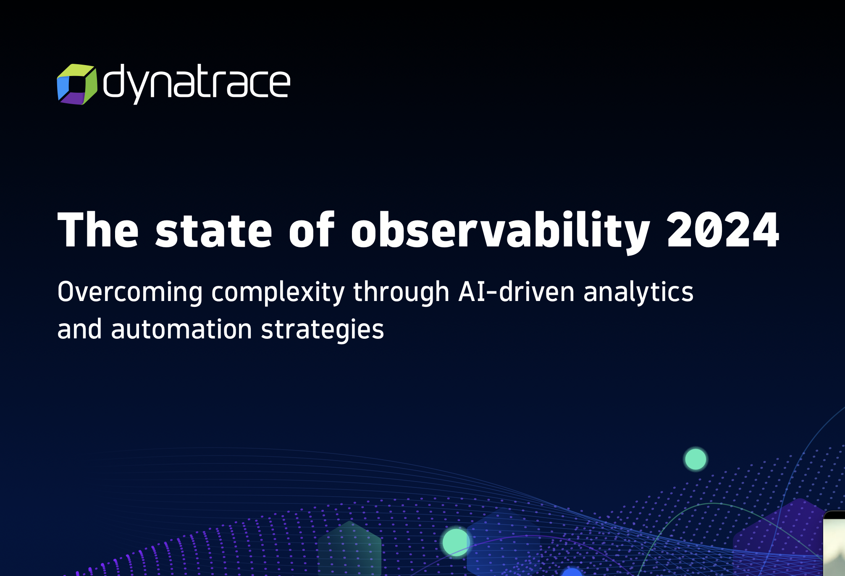

Slide 72
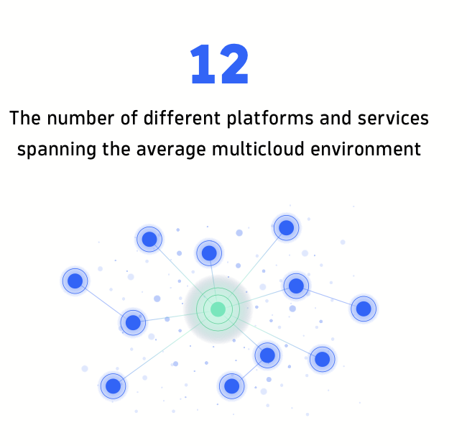
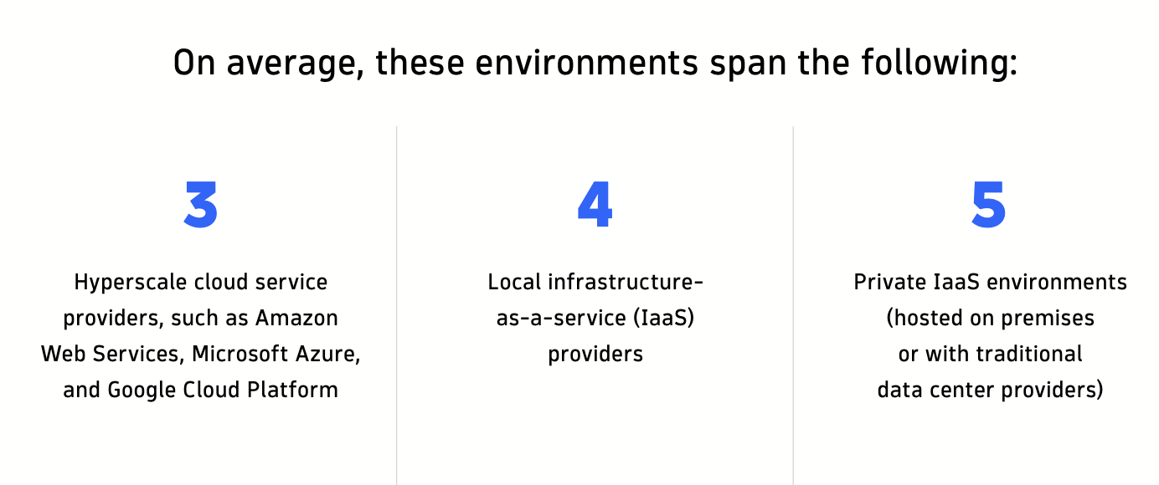

Slide 73
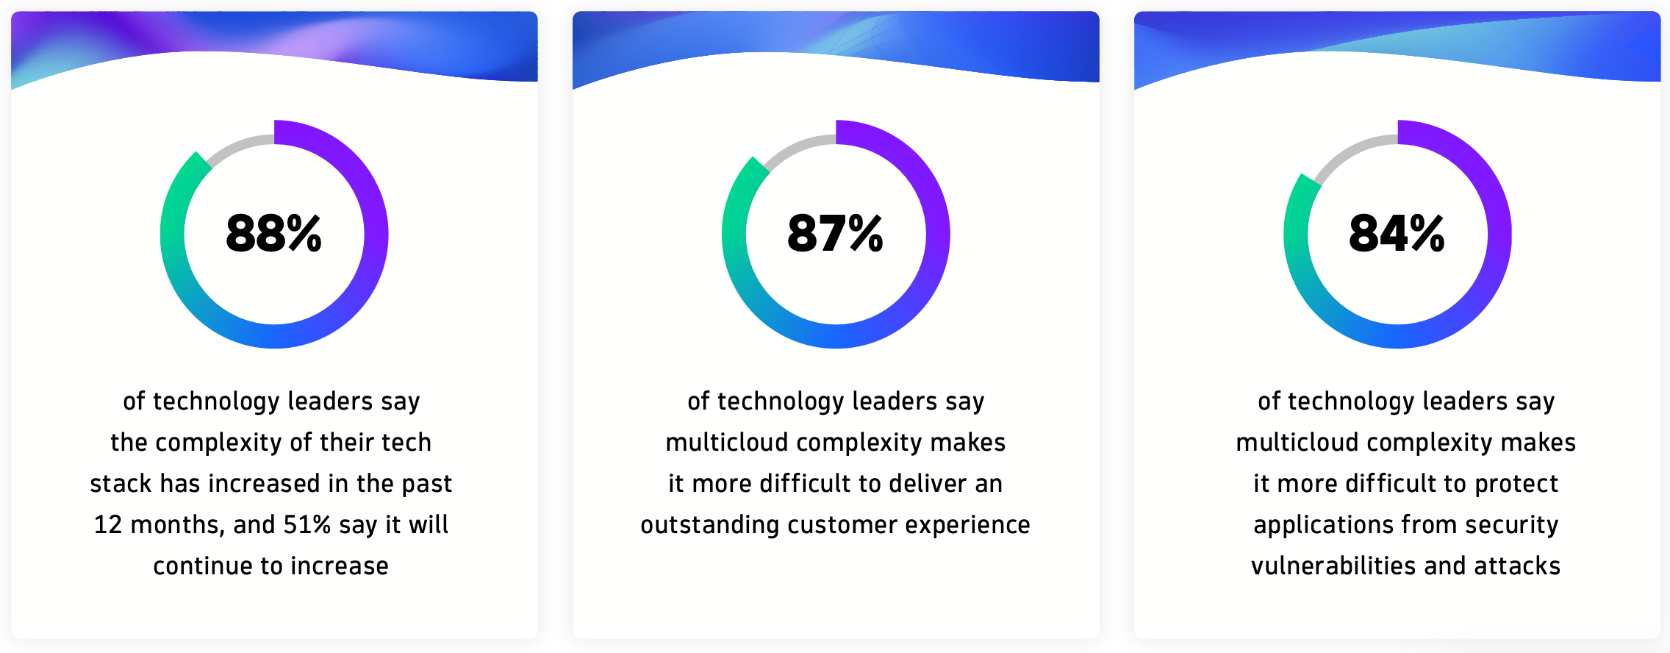
IT and security teams: difficult to monitor and manage applications

Slide 74
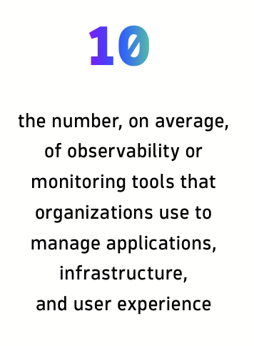
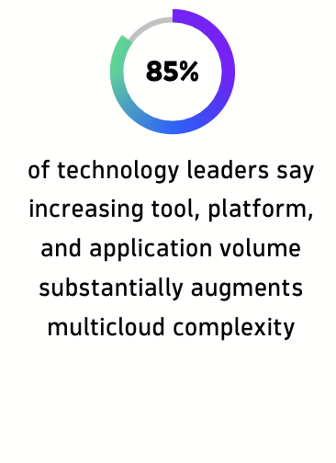
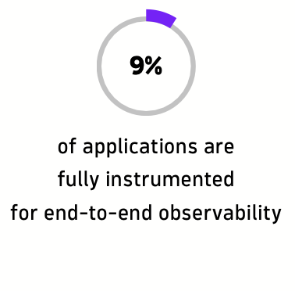
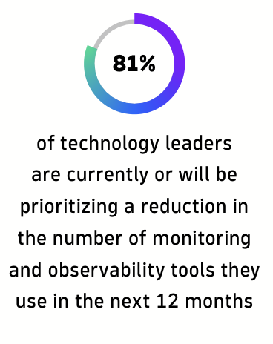
Fragmented monitoring and analytics can’t keep up

Slide 75
Principle we are arguing here…
“Monitor smarter, not more!”

Slide 76
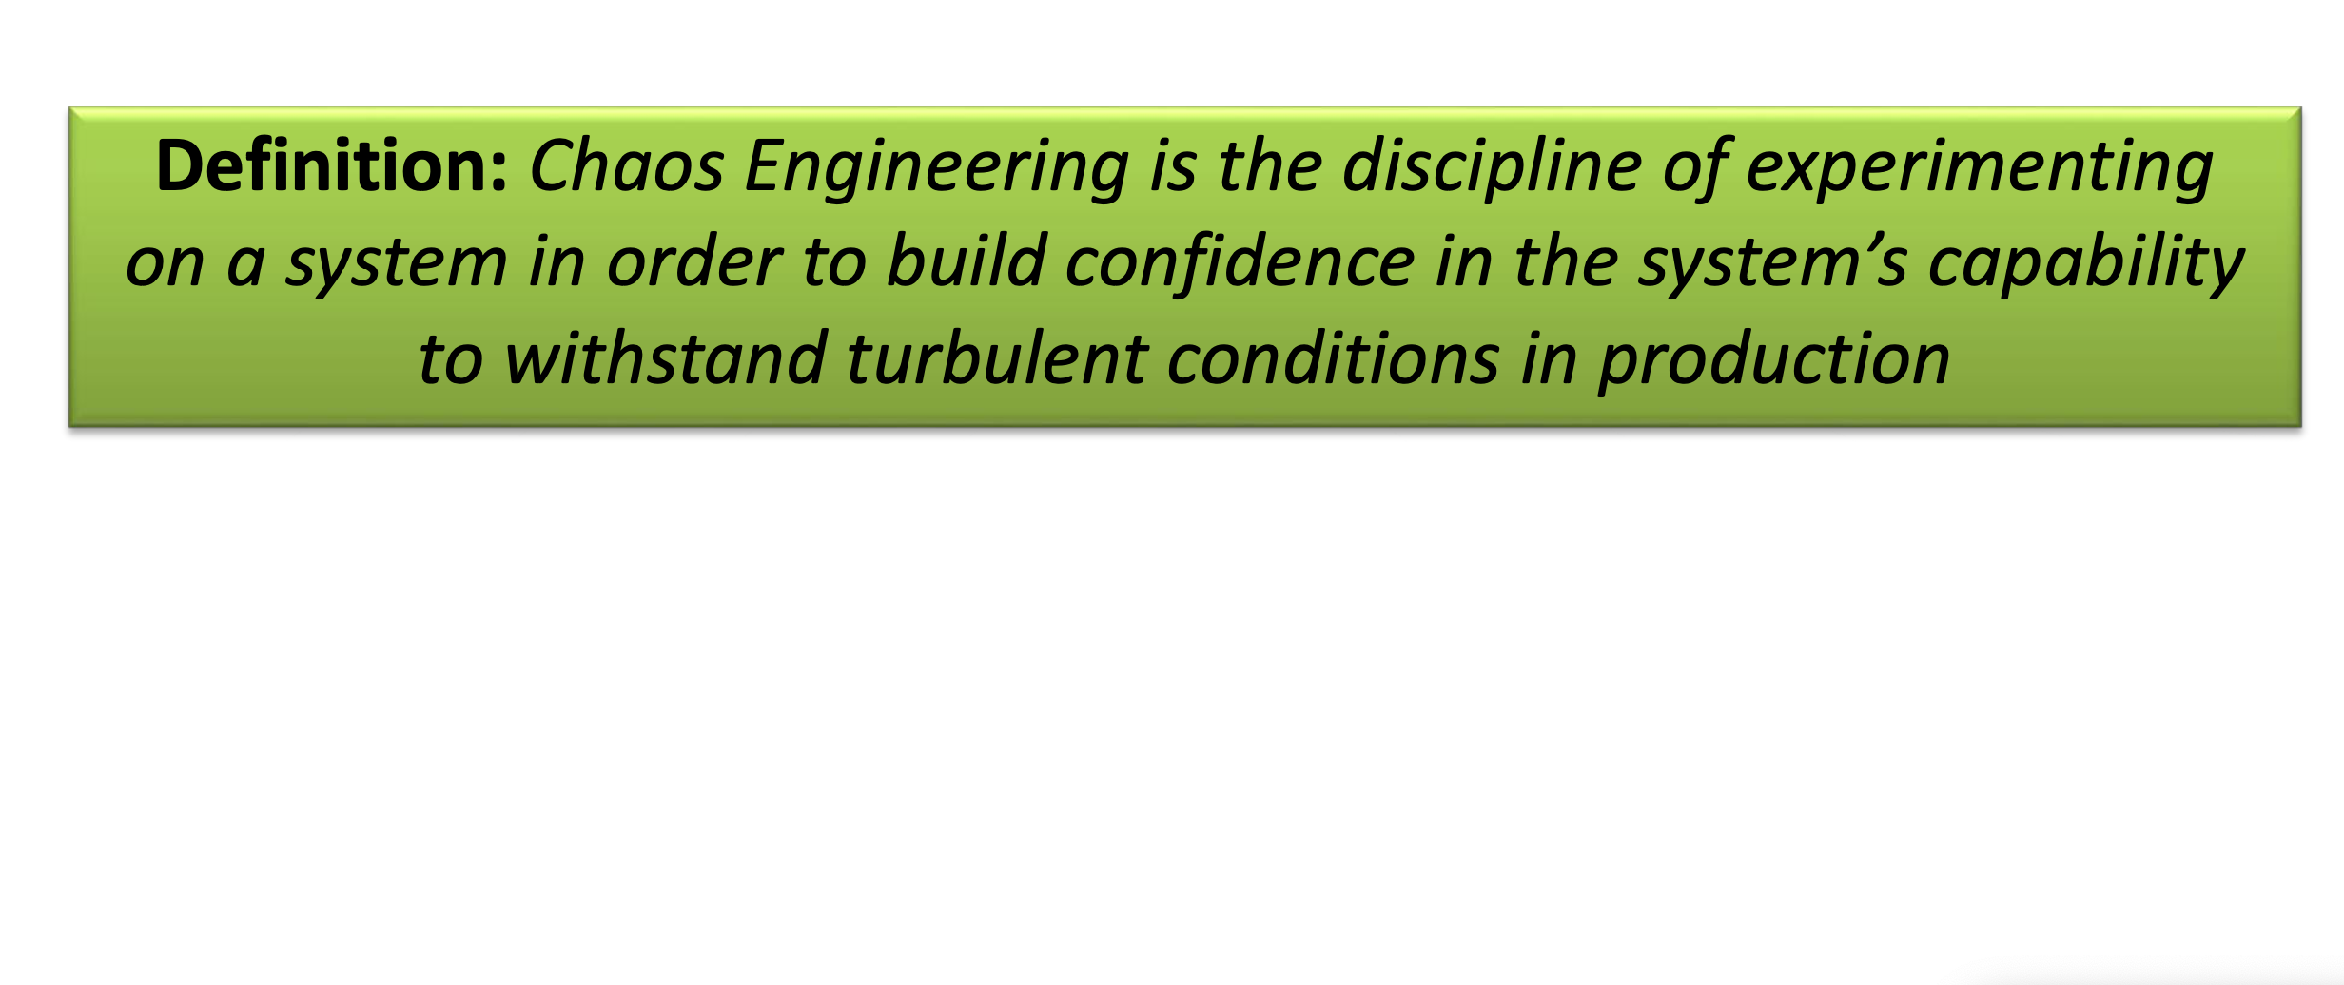
Chaos Engineering Explained

Slide 77
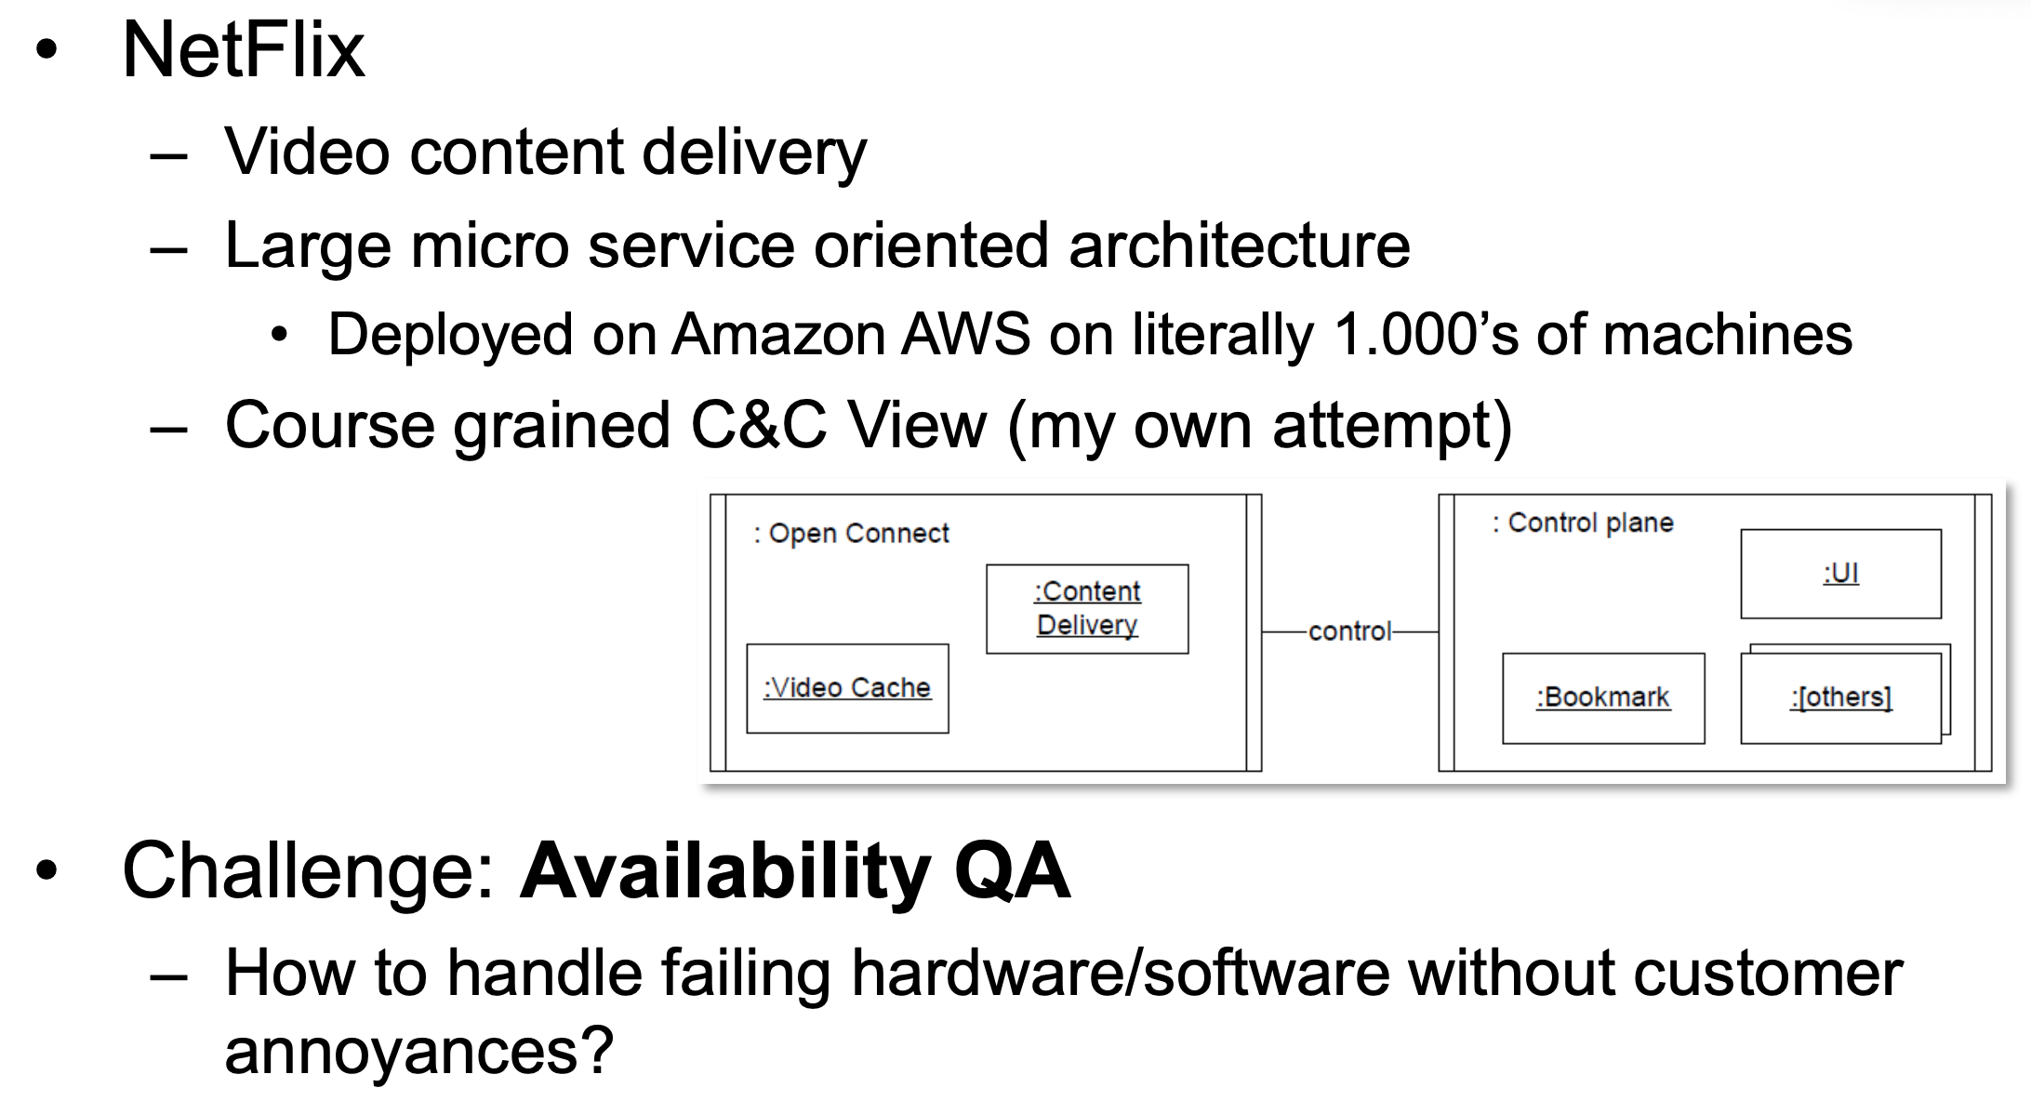
Origin: Netflix

Slide 78
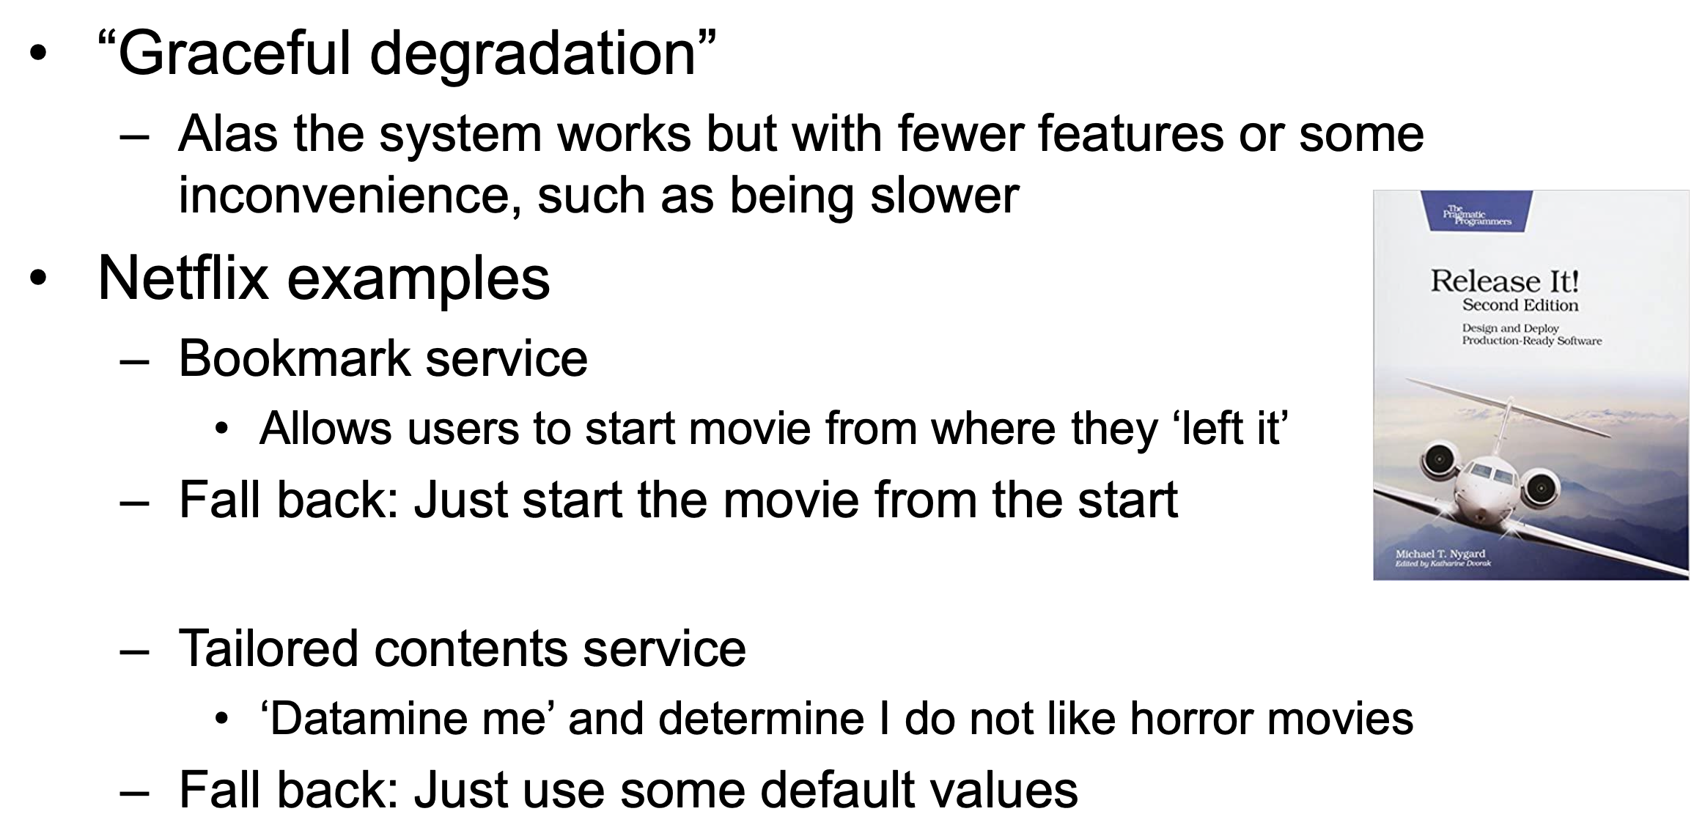
Architectural Tactic: Design for Failure

Slide 79
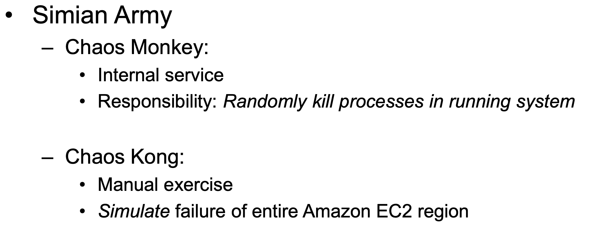
Simian Army Approach

Slide 80
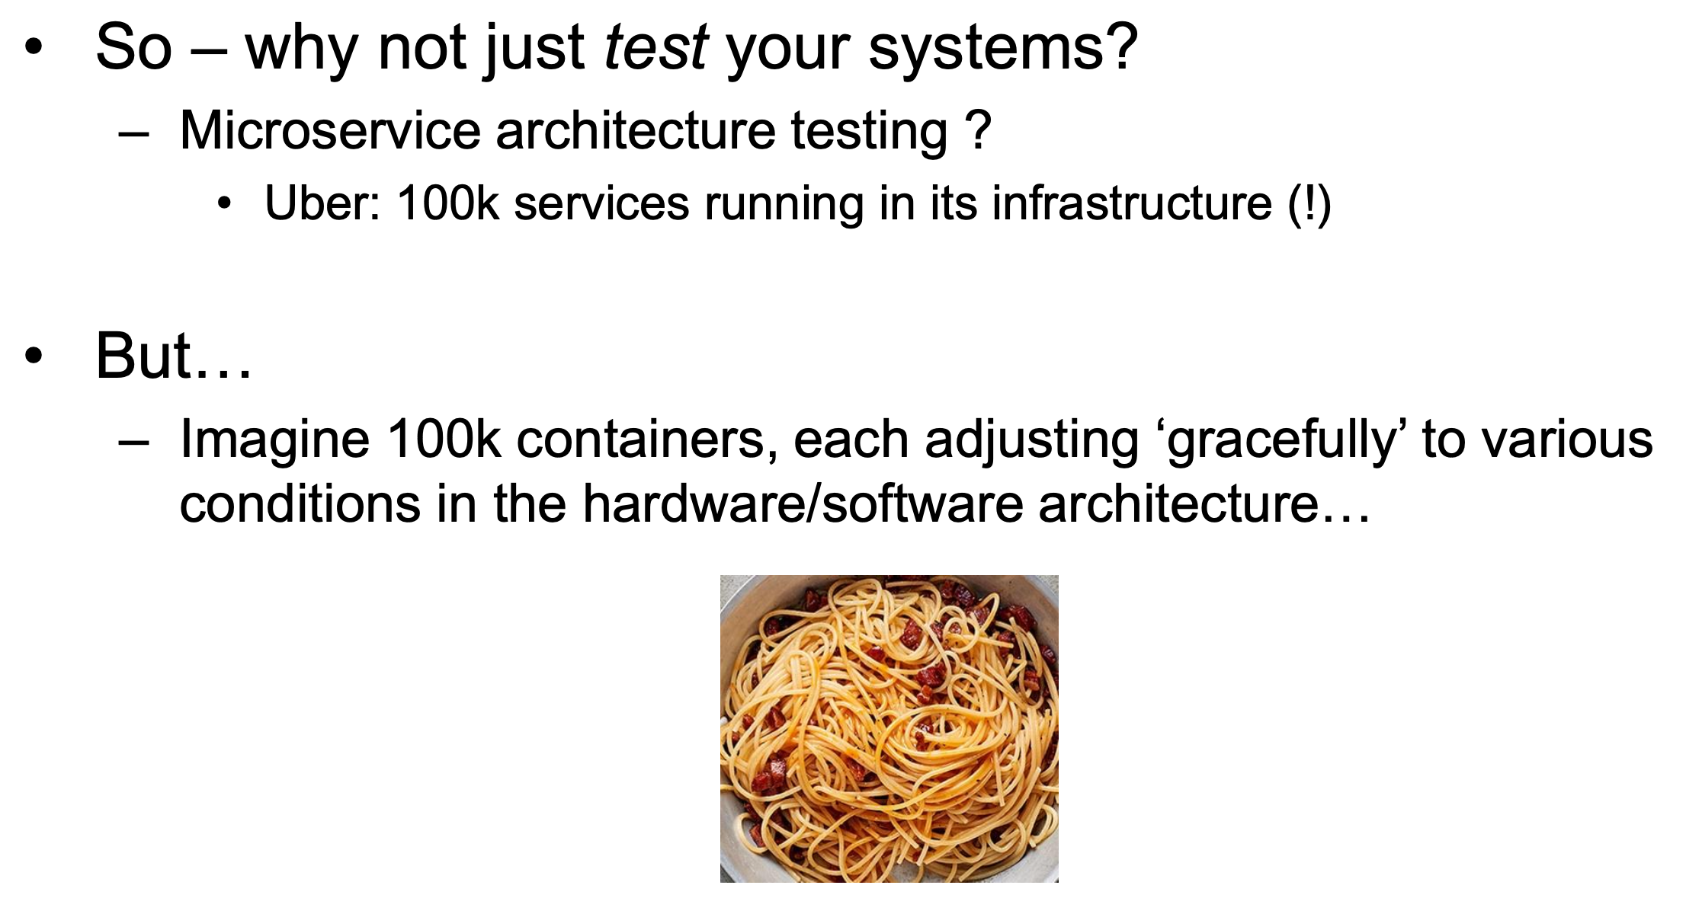
Wait a sec…
Notes:
https://www.infoq.com/news/2017/11/expedia-resiliency/

Slide 81
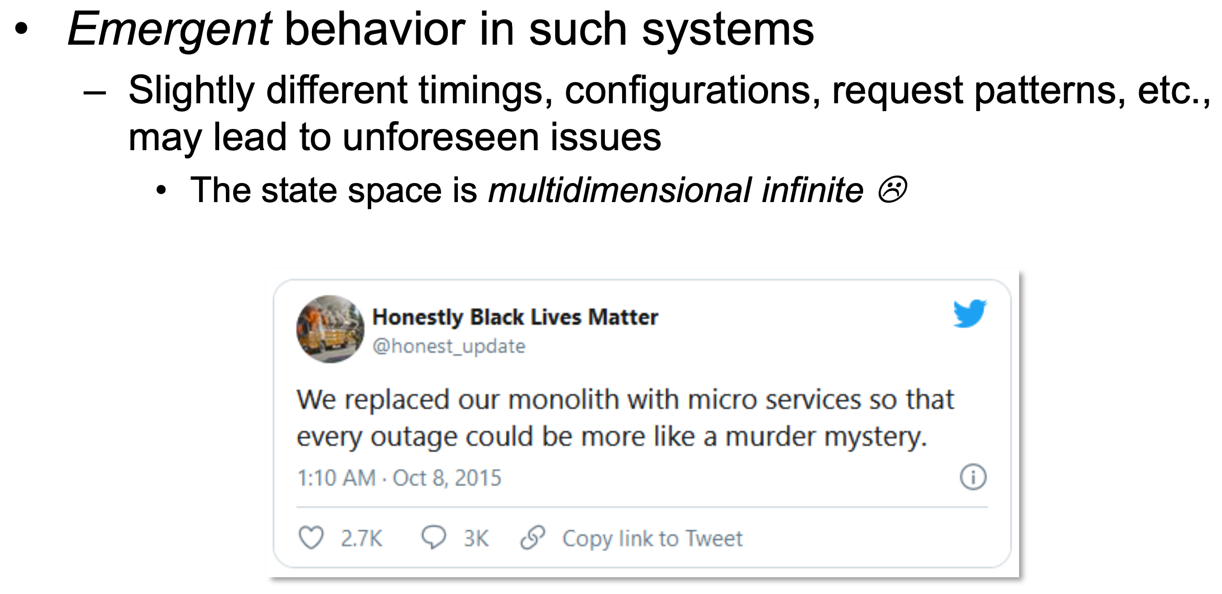
How about Emergent Behaviour?

Slide 82
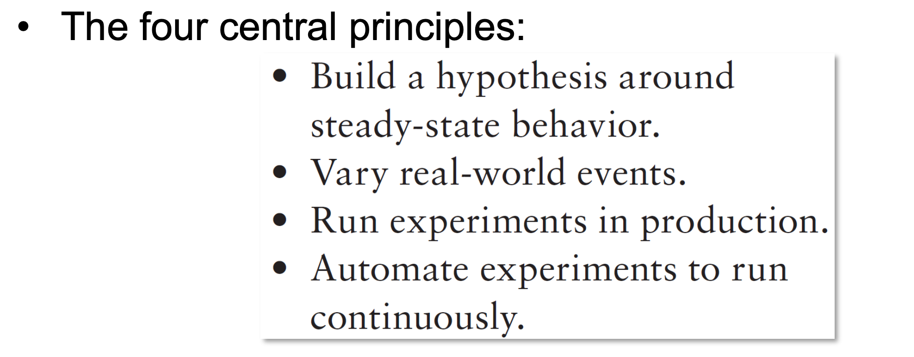
Chaos Engineering Explained

Slide 83

SideBar: Chaos Theory

Slide 84

The Scientific Method in Cloud-Native ☺

Slide 85

Principle 1: Steady-State Behavior

Slide 86

Principle 1: Steady-State Behavior

Slide 87

Principle 2: Real-World Events

Slide 88


Slide 89

E.g., Vary real-world events…

Slide 90

E.g., Vary real-world events… (cont’d)

Slide 91

Principle 3: Experiments in Production

Slide 92

Principle 4: Automate Experiments!

Slide 93

Principle 4: Automate Experiments in Production!

Slide 94
Step 1: Running Experiments!

Slide 97



Step 2: Explaining what happened!

Slide 98
Step 2: Explaining what happened!
Human Element remains the only weakness!

Slide 99
Solution?

Slide 100




Slide 101
Prediction Job
Ensure Sys. Observability
Elicit Metrics
Predict Hypothesis
Run Chaos Experiment
Compare
Repeat

Slide 102

Prediction Job
Ensure Sys. Observability
Elicit Metrics
Predict Hypothesis
Run Chaos Experiment
Compare
Repeat

Slide 103

Prediction Job
Ensure Sys. Observability
Elicit Metrics
Predict Hypothesis
Run Chaos Experiment
Compare
Repeat

Slide 104

For Example*…
*
µS ➔ Infrastructure Code!

Slide 105


Slide 106
Putting it all together…
Continuous Defect Pred. for Hypo. Form.
Highly Observable Infrastructures & µS
Chaos Engineering Experimentation
Compare Hypo. with Exp.
Evaluate & Explain
Repeat!

Slide 107
Putting it all together…
Continuous Defect Pred. for Hypo. Form.
Highly Observable Infrastructures & µS
Chaos Engineering Experimentation
Compare Hypo. with Exp.
Evaluate & Explain
Repeat!
Explainable Orchestration!

Slide 108


Slide 109
Recommended Resources
Introduction to DevOps: Transforming and Improving Operations – edx.org – The Linux Foundation
Spotify Engineering Culture
https://www.youtube.com/watch?v=Mpsn3WaI_4k&list=PLC3mk_XNnmVS7HG_nhNr3I1VQ-2eL2XgB
Transforming Software Development – Amazon Web Services
https://www.youtube.com/watch?v=YCrhemssYuI
My Personal DevOps Playlist on Youtube
https://www.youtube.com/playlist?list=PLOw-K6HoPAvxU39zL4ki4YmBR-r5ihSKV

